Slide 1



World Education and Happiness
U of A Bootcamp 2020
Contributors:
Cassian Samaniego, Ran Wei and Steve Ovsak

Slide 2

Selecting the data
The team used Kaggle.com to pull the csv data required to analyze the data
Datasets used:
World Bank: Education Data CSV
https://www.kaggle.com/theworldbank/world-bank-intl-education?select=international_education
World Happiness Report CSV
https://www.kaggle.com/unsdsn/world-happiness
Wikipedia API
https://en.Wikipedia.org/w/api.php
The data obtained from the sources will be utilized to generate comparisons of the world’s population based on education levels and their overall happiness.
An attempt was tried on using Bigquery to pull the data with out using CSV Files

Slide 3
The data transformation
Clean:
The data will first be pulled with CSVs and cleaned utilizing pandas
Join:
The data will be joined by counties within the datasets
Filter:
The information from the world’s education and their happiness and include a link to the Countries Wikipedia Page

Slide 4
Data Notes
Education percentage note:
Total enrollment in primary and secondary education, regardless of age, expressed as a percentage of the total population of official primary and secondary education age. GER can exceed 100% due to the inclusion of over-aged and under-aged students because of early or late school entrance and grade repetition.
GER = Gross Enrollment Ratio
Total enrollment in primary and secondary education, regardless of age, expressed as a percentage of the total population of official primary and secondary education age.
SLE = School Life Expectancy
Number of years a person of school entrance age can expect to spend within the specified level of education.

Slide 5
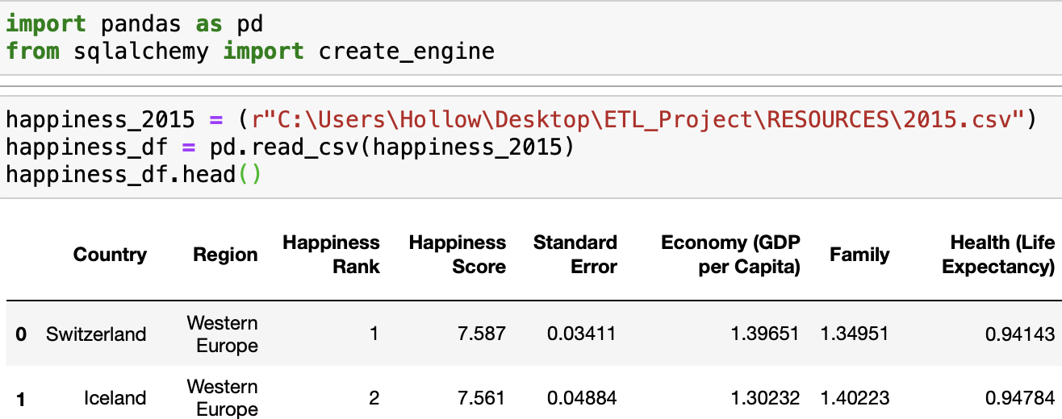

Cleaning DataSets
The team utilized jupyter notebooks and pandas to get each of the datasets ready to join the tables
Happiness Example:

Slide 6
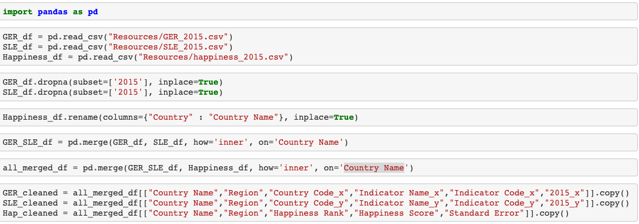
Cleaning Continued
Combining and renaming columns:

Slide 7
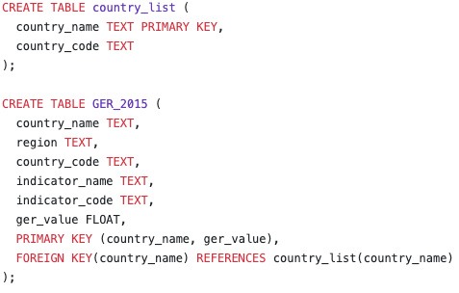
Creating the Tables
We used SQL to create the tables and join the data on the year and countries. Also added were Wikipedia links to all the countries compared
Table Examples:

Slide 8
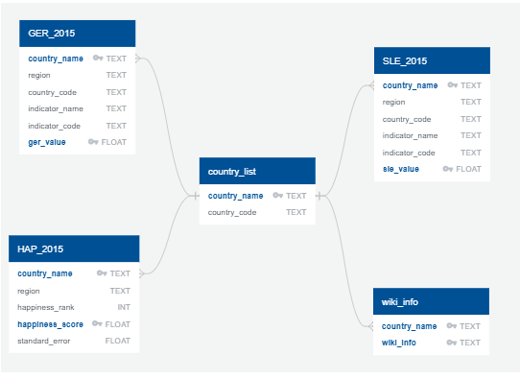
Final production database - Relational
We utilized Postgres to better update in the future when new years are added to the World Bank information.
TABLES:
GER_2015
SLE_2015
HAP_2015
country_list
wiki_info

Slide 9
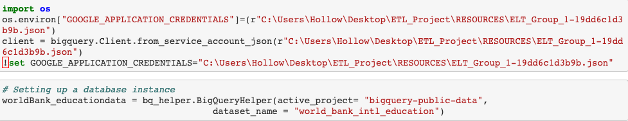
Questions?
Example of the Bigquery starter:

